Slide 1


Disney+HotStar Data Analysis
By
Suvashini S
Notes:
1

Slide 2

Problem statement
Provide an in-depth analysis and visualization of a movie dataset to uncover insights and trends. This includes understanding the distribution movies by genre, running time, release year, age rating and other attributes.

Slide 3




Business Use Cases
Content Strategy Audience Segmentation
Marketing Campaigns Historical Analysis

Slide 4
Tasks
1. Distribution of Movies by Genre 7. Most Common Movie Types
2. Average Running Time by Genre 8. Correlation Between Running Time and Year
3. Movies Released Each Year 9. Genre Popularity Over Time
4. Top 10 Longest Movies 10. Movies by Genre and Age Rating
5. Movies by Age Rating 11. Movies with Maximum Episodes
6. Count of Movies by Year and Genre 12. Distribution of Running Time
13. Analysis of Specific Genres

Slide 5
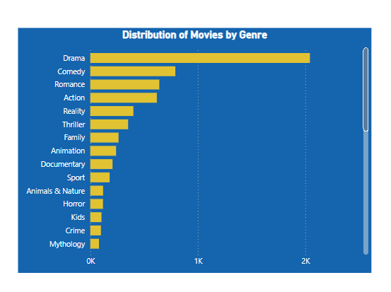
1. Distribution of Movies by Genre
Findings:
The genre with the highest number of movies is “Drama” followed by “Comedy” and “Romance”.
Some genres like “Lifestyle” and “Food” have significantly fewer movies compared to others.
Insights:
The highest count of Drama and Comedy movies suggest these genres are popular and frequently produced.
The low count in specific genres might indicate niche markets or less audience interest.

Slide 6
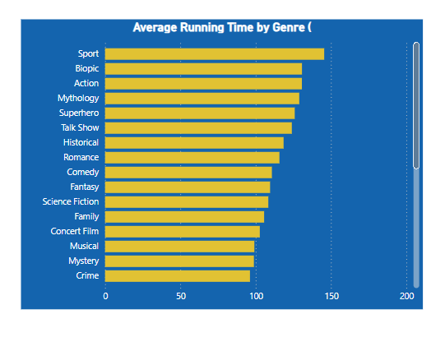
2. Average Running Time by Genre
Findings:
Genres like “Action” and “Biopic have higher average running times compared to genres like “Science” and “Standup Comedy”.
Insights:
Action and Biopic often require more screen time to cover detailed information and narratives, leading to longer average running times.
Shorter running times in genres like science and standup comedy may cater to the preference o their target audiences.

Slide 7
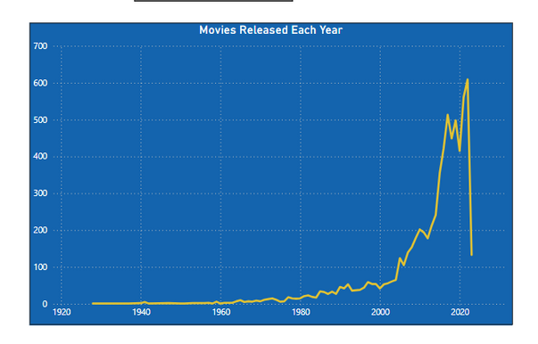
3. Movies Released Each Year
Findings:
The number of movies released annually has shown a flat line from 1940 to 2000, and there is a noticeable peaks after 2000.
Insights:
The increase in movies release could be due to advancements in technology, changes in consumer demand, and growth in the entertainment industry.
Peaks in specific years might be linked to significant industry events or trends.

Slide 8
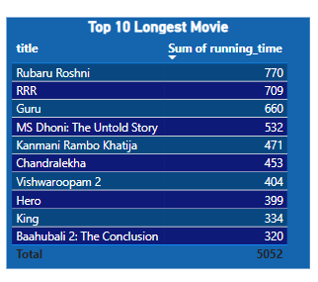
4. Top 10 Longest Movie
Findings:
The longest movie in the dataset is “Rubaru Roshni” with a running time of 770 minutes.
Insights:
Long movies often have complex plots or extensive narratives requiring extended screen time.
The top 10 longest movies are primarily from genres like “Drama” and “Action”.

Slide 9
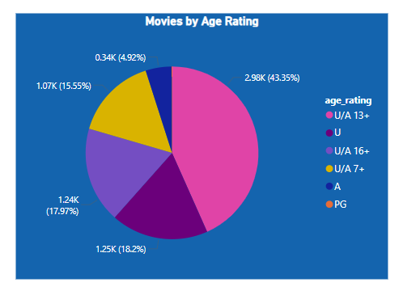
5. Movies by Age Rating
Findings:
All the movies are fall under equal proportion of ratings.
From this “U/A” is top with 43.35%.
Insights:
The prevalence of “U/A” rated movies suggest that producers are targeting a broader adult audience.
The “A” rated movies contains adult and violence so family audience and children are don’t watch it.

Slide 10
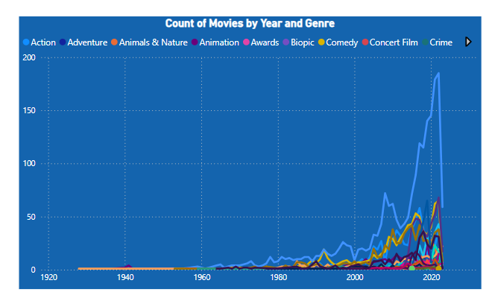
6. Count of Movies by Year and Genre
Findings:
The number of movies in genres like “Drama” and “Comedy” has increased steadily over the years.
Some genres, like “western” and “Musical”, has seen little to no growth.
Insights:
The growth in popular genres could reflect changes in audience preferences and industry trends.
The stagnation in certain genres might suggest a niche or declining interest.

Slide 11
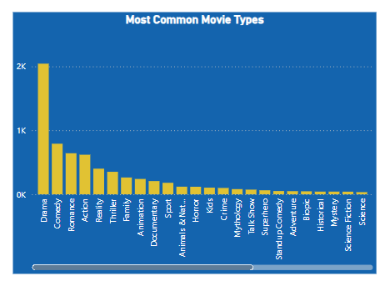
7. Most Common Movie Types
Findings:
The majority of the dataset consists of Drama followed by Comedy.
Insights:
The dominance of Drama indicates this format are the most produced.
Less common types might cater to specific audience segments or serve niche markets

Slide 12
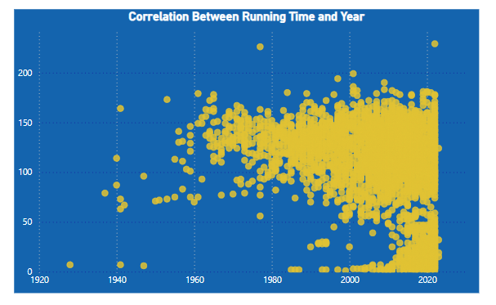
8. Correlation Between Running Time and Year
Findings:
Over the years, the running time of movies are gradually decreased.
Insights:
Nowadays people don’t have patients to watch longer running time movies.
So slight decrease in running time in recent years that might reflect changes in production styles or audience preferences.

Slide 13
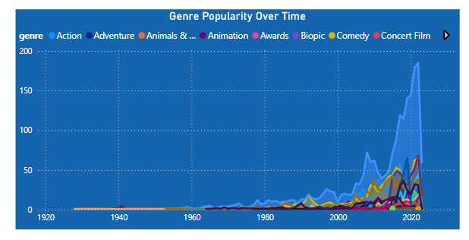
9. Genre Popularity Over Time.
Findings:
Genre like “Drama” have seen consistent popularity, with noticeable peaks from 2007 to now.
Insights:
The consistent popularity of certain genres indicates stable audience interest.
The growth in specific genres might be driven by trends, technological advancements or changes in audience preferences.

Slide 14
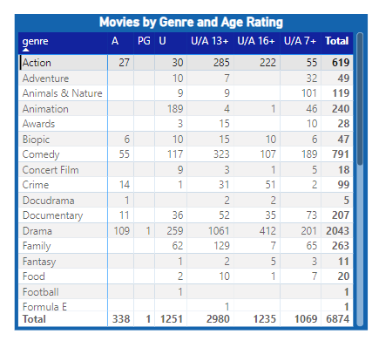
10. Movies by Genre and Age Rating
Findings:
Most genre have a diverse of age ratings, with “U” , “U/A 13+” and “PG” being the most common across genres.
Insights:
The diversity in age ratings across genres indicates a board target audience.
Sports genres like “Football” naturally have lower age ratings.

Slide 15
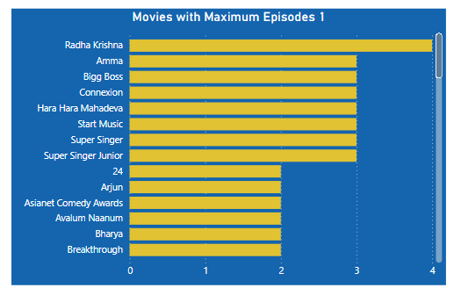
11. Movies with Maximum Episodes
Findings:
The movie with the highest number of episodes is “Radha Krishna”.
Insights:
TV shows with multiple episodes are likely part of series or anthologies, offfering extended content to the audience.
These TV shows may attract viewers who prefer longer, serialized content.

Slide 16
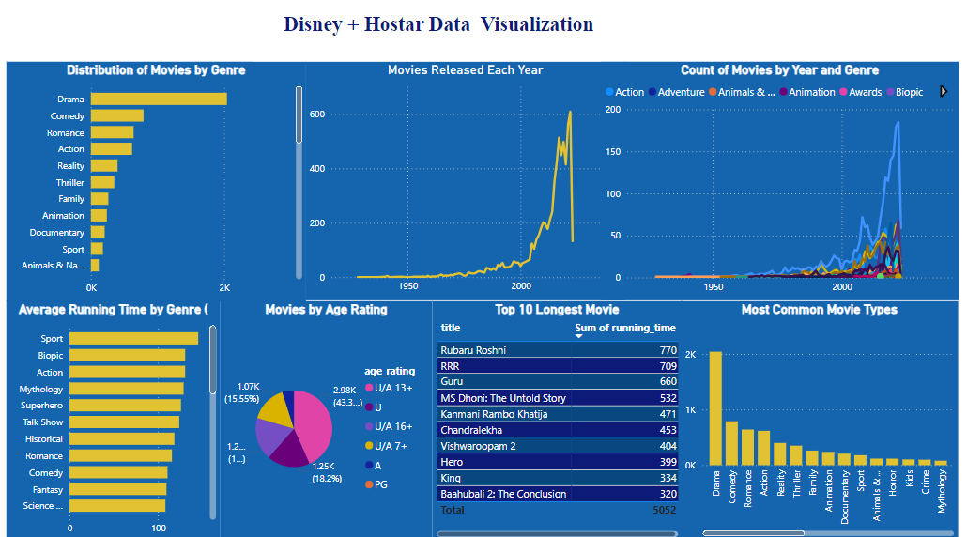
DASHBOARD

Slide 17
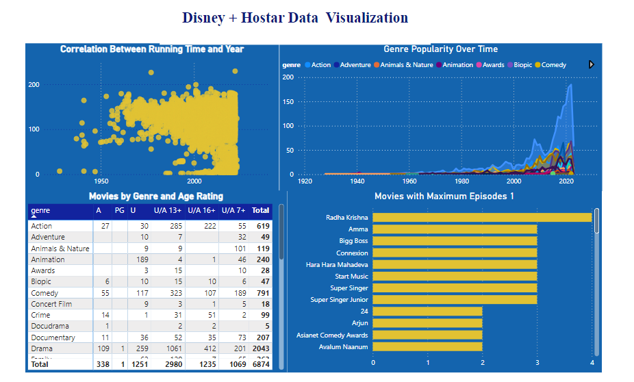
DASHBOARD

Slide 18
RESULT of ANALYSIS
Genre Distribution : The most popular genres on Disney+ HotStar are Action, Comedy, and Drama. Documentaries and Horror genres are less represented in the dataset, indicating niche audiences.
Running Time : Action and Drama movies generally have the longest runtimes, averaging between 120-150 minutes. Documentaries and Animation movies tend to have shorter runtimes, averaging around 70-90 minutes.
Release Trends : The number of movie releases saw a significant increase in the last few years, especially around 2019-2020, likely due to the rise of streaming during the COVID-19 pandemic. A noticeable dip in movie releases in 2022 suggests potential challenges or market adjustments in the post-pandemic era.
Age Rating : The majority of movies are rated PG-13 and R, targeting a mature audience. Family-friendly movies are well represented with PG and G ratings, particularly in genres like Animation and Children's movies.

Slide 19
CONCLUSION
The analysis of the Disney+ HotStar movie dataset reveals key trends that can guide content strategy, audience segmentation, and marketing efforts. The most popular genres are Action, Comedy, and Drama, with a growing interest in Sci-Fi and Animation. Movies tend to have longer runtimes, particularly in Action and Epic Drama genres, while family-friendly content is prevalent in PG and G ratings.
There has been a significant increase in episodic content, indicating a shift towards TV shows and multi-episode formats. The findings highlight opportunities for personalized content recommendations based on age ratings and running times.
Overall, the insights suggest that Disney+ HotStar should continue focusing on high-demand genres, invest in TV shows, and tailor content to evolving audience preferences, ensuring a competitive edge in the streaming market.
The analysis of the Disney+ HotStar movie dataset reveals key trends that can guide content strategy, audience segmentation, and marketing efforts. The most popular genres are Action, Comedy, and Drama, with a growing interest in Sci-Fi and Animation. Movies tend to have longer runtimes, particularly in Action and Epic Drama genres, while family-friendly content is prevalent in PG and G ratings.
There has been a significant increase in episodic content, indicating a shift towards TV shows and multi-episode formats. The findings highlight opportunities for personalized content recommendations based on age ratings and running times.
Overall, the insights suggest that Disney+ HotStar should continue focusing on high-demand genres, invest in TV shows, and tailor content to evolving audience preferences, ensuring a competitive edge in the streaming market.

Slide 20




